Slide 1


ANDROID DEVELOPMENT COURSE 1
Final Project
QuizApp
A trivia application for android
Full Name: Sagi Dahari

Slide 2
OVERVIEW
QuizApp is an interactive quiz application for Android designed to test users knowledge on various topics. It provides customizable quiz settings and an engaging user experience.
Users can make an educational gain by viewing the correct answers to a question that will be displayed in green and the incorrect answers will be displayed in red.
2

Slide 3
THE APP'S SCREENS
3

Slide 4
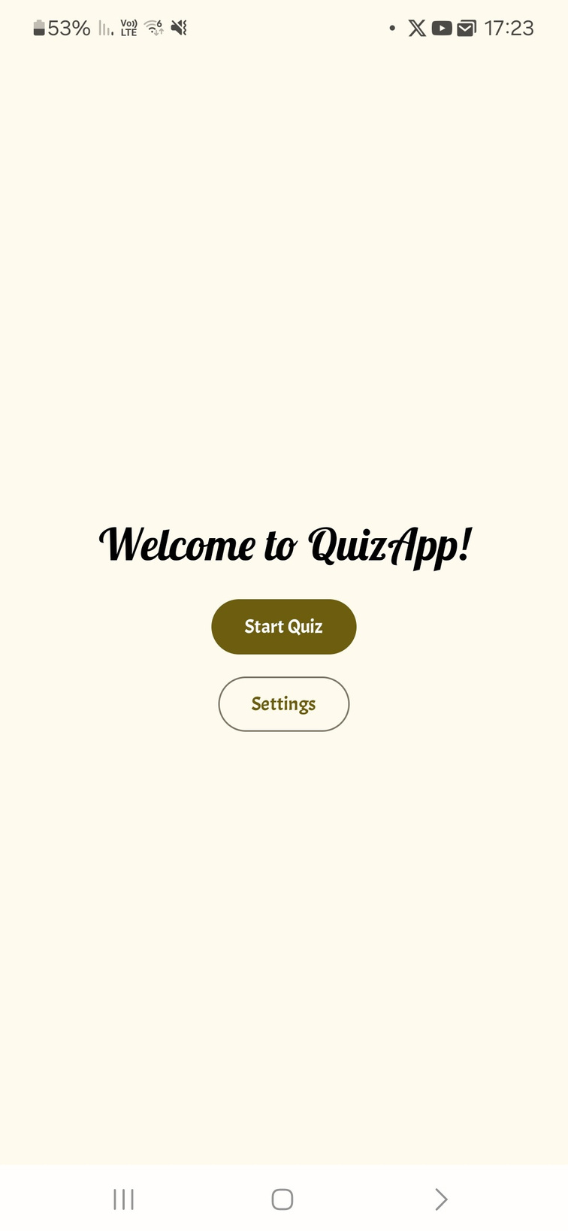
Home Screen
The Home Screen is the opening screen for the app.
It allows the user to navigate to the quiz screen, and to the settings screen.
once a user clicks on the quiz screen, an API call is been triggered and fetches the questions data.
4

Slide 5
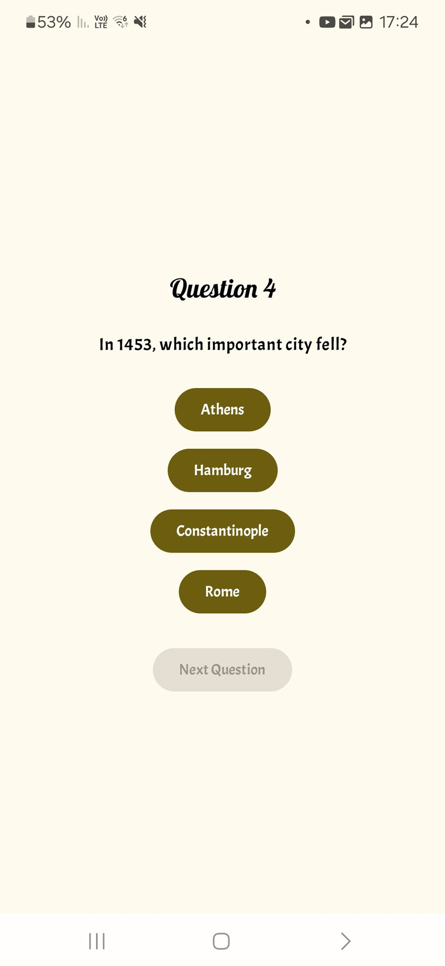
Quiz Screen
The Quiz Screen is the app's main screen,
it allows the users to view the current question
and it's answers, the user will click on the answer that he thinks is the correct one.

Slide 6
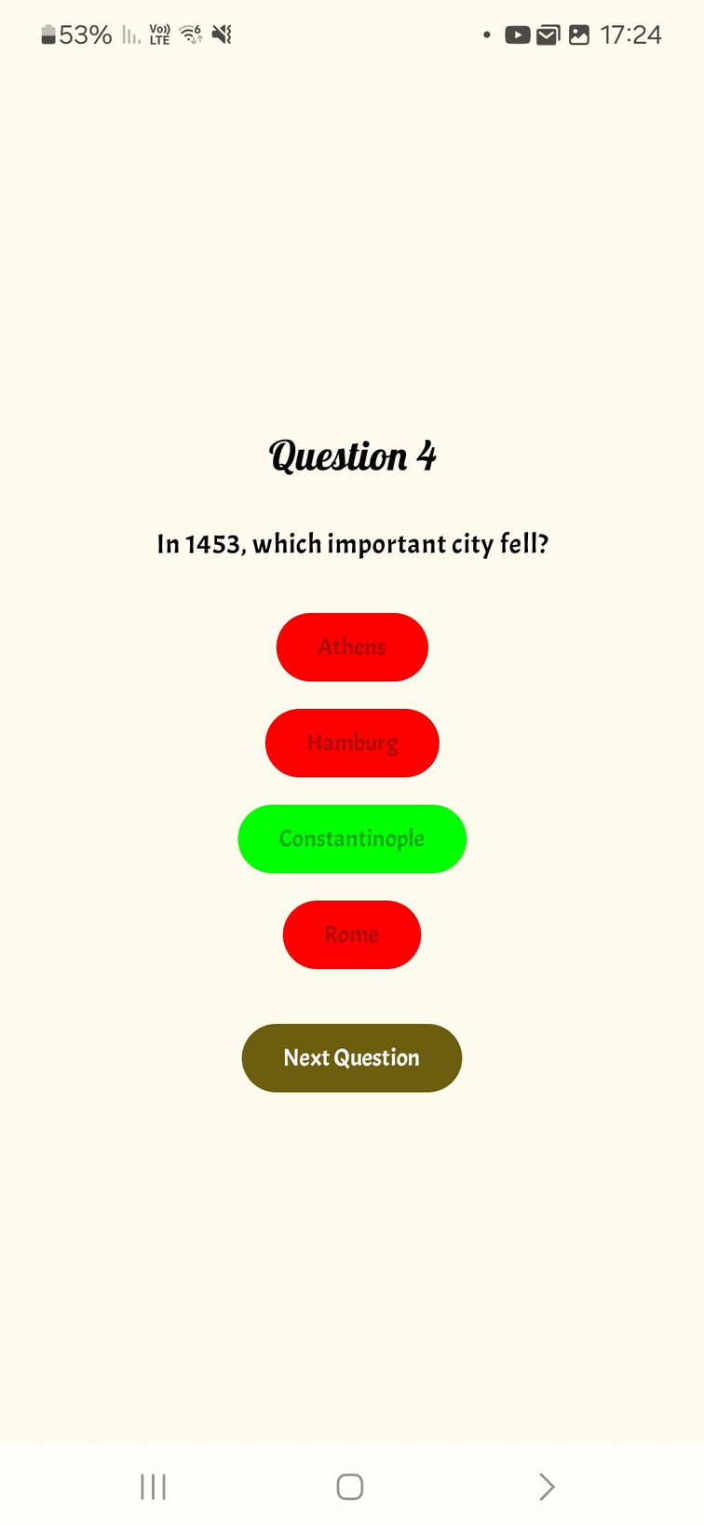
Quiz Screen
After an answer has been clicked, the correct answer will be highlighted in green and the incorrect answers will be highlighted in red, In addition the Next Question / Finish Quiz button will be enabled, also the app is keeping track of the number of questions that the user has answered correctly, and will display it in the Results Screen

Slide 7
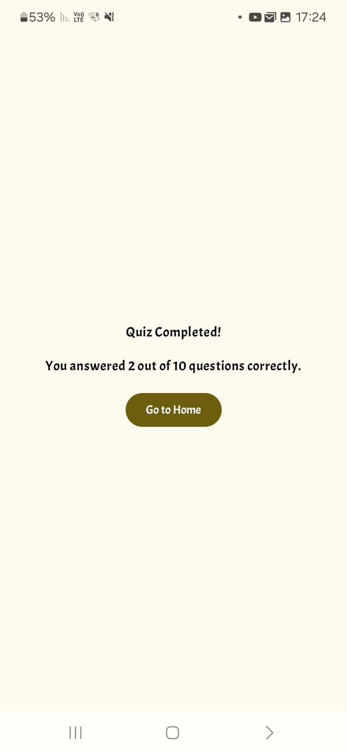
Results Screen
The Results Screen gets as parameters from the Quiz Screen the score and the number of questions in order to display them, also there is a Go to Home button that navigates to the Home Screen.

Slide 8
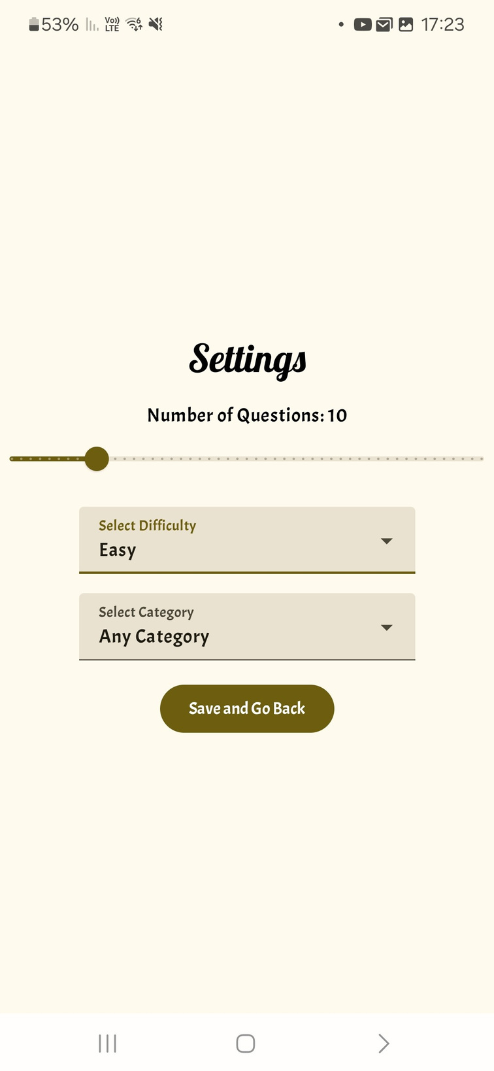
Settings Screen
In the Settings Screen, the user can change the number of questions, select a category, and change the quiz's difficulty.
once the Save and Go Back button is clicked a function resets the states of those parameters in the View Model with the newly chosen parameters.
Once a quiz will start from the Home Screen, The app will make an API call with the new settings, in order to fetch the new questions.

Slide 9
For all purpose
THANK YOU
ENJOY THE APP

